Slide 1

Winterbourne Babysitter

Slide 2
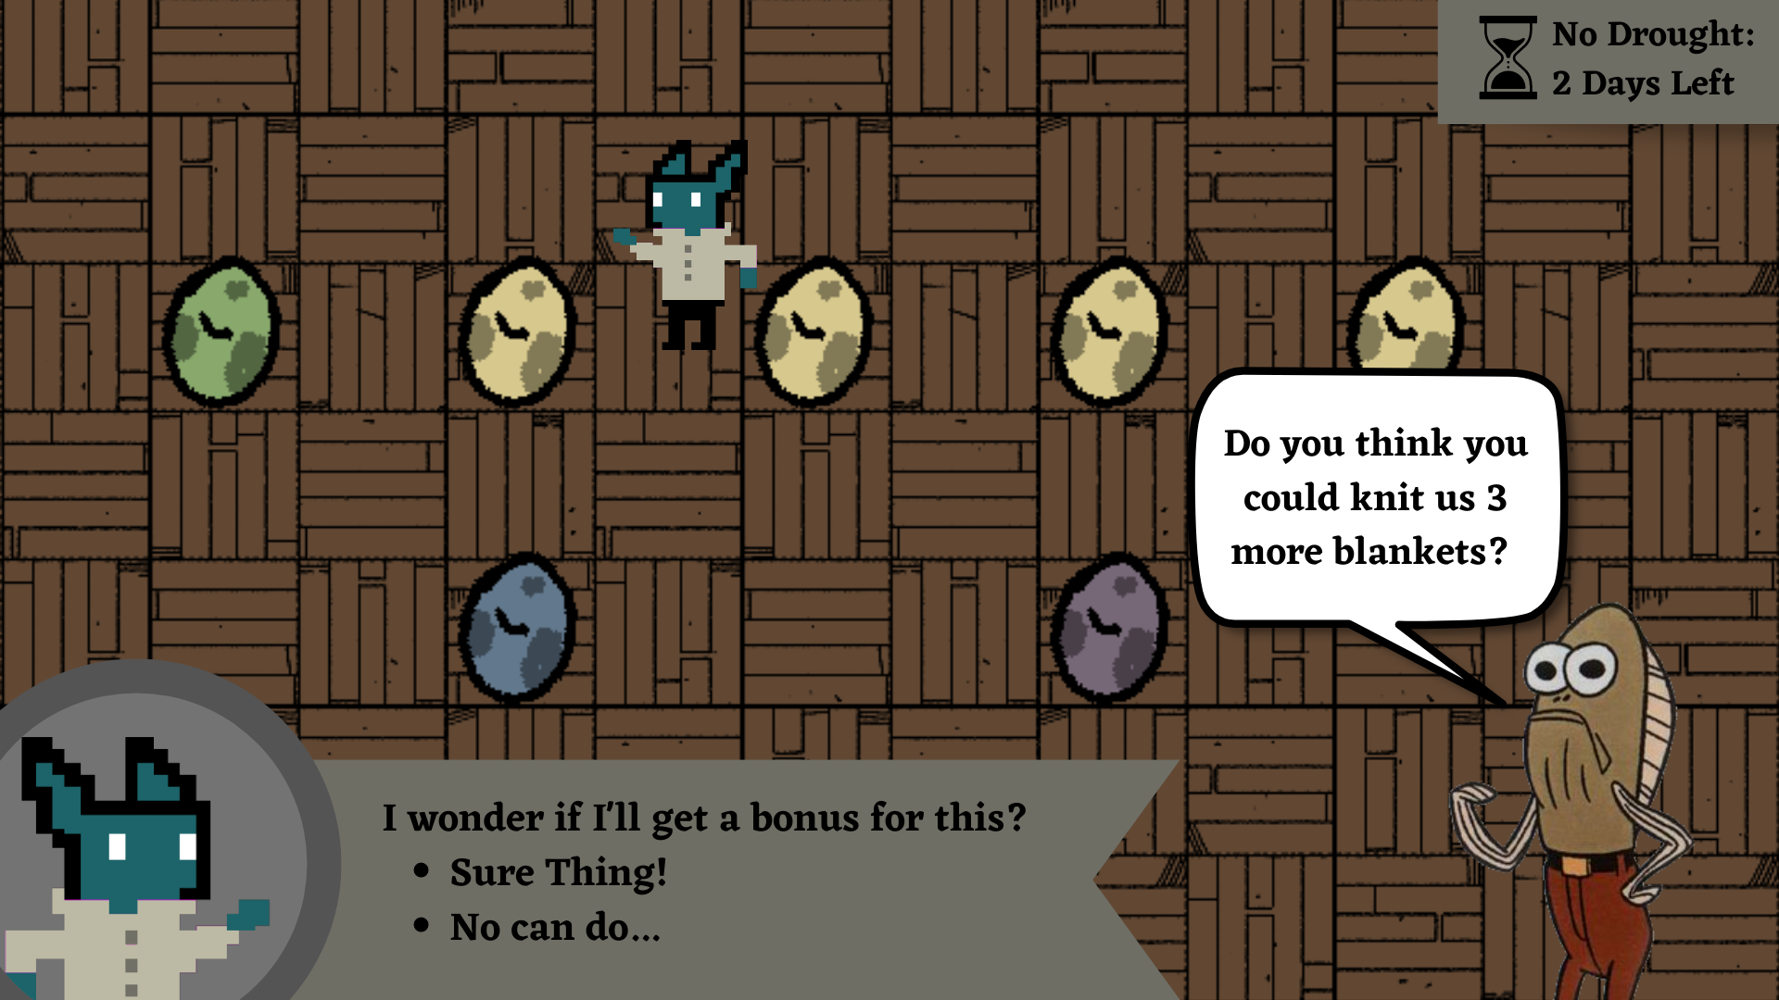

Slide 3
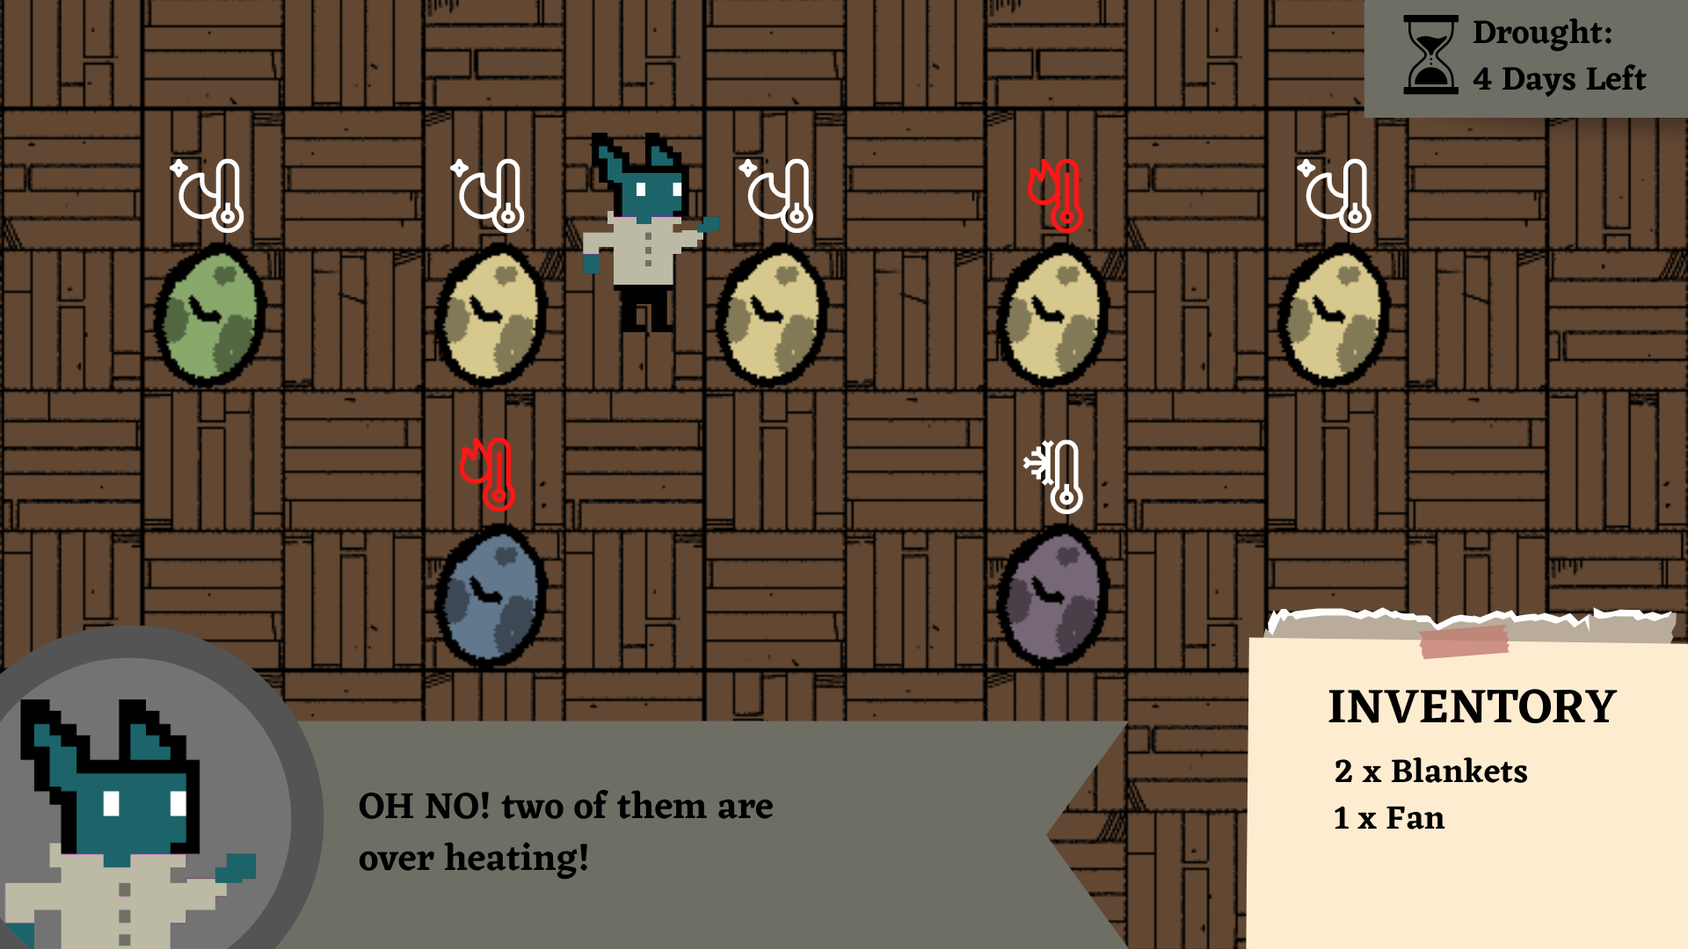

Slide 4
UNESCO ESD Competencies
Critical Thinking Competency
Anticipatory Competency
Self Awareness Competency
UN Sustainable Development Goals (SDGs)
Climate Action
Life Below Water
Sustainable Consumption
Guidelines
National Learning Network Guidelines
COBLIS (Colour Blindness Simulator Tool)
Education for Sustainable Development Guide

